Slide 1
MITOSIS AND THE CELL CYCLE

Slide 2
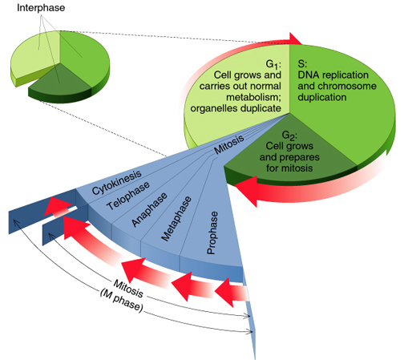
The Cell Cycle

Slide 3
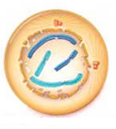
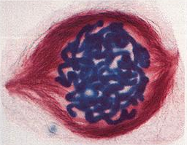
Mitosis
  Cells divide to produce 2 daughter cells with the same number of chromosomes as the parent cell
  This is used for growth and repair.
Prophase (first stage)
Chromatids condense
Nuclear membrane breaks down
Centrioles separate

Slide 4
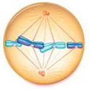
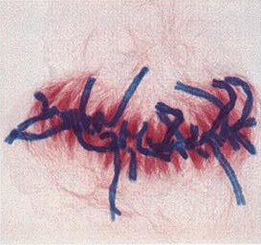
Metaphase
Spindle forms
Chromosomes line up across the equator, joined to spindle at their centromeres

Slide 5
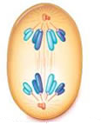
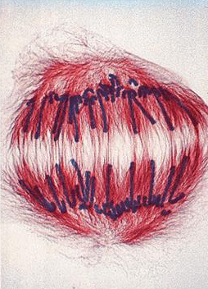
Anaphase
  Chromatids are pulled to opposite poles by the spindle fibres

Slide 6

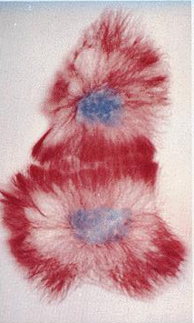
Telophase
Chromosomes uncoil
Nuclear membrane reforms
Cell divides (= cytokinesis)

Slide 7
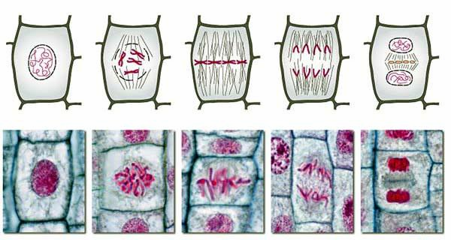
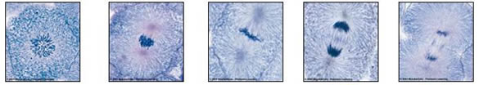
Comparing Animal to Plant
Here are some stages of mitosis in an animal cell
And these diagrams and photos show mitosis in a plant cell

Slide 8
Functions of Mitosis
1. Growth
E.g. from zygote to adult
Plant stems and roots grow at tips
2. Repair
E.g. wounds
Lizards grow new tails
3. Reproduction
E.g. some simple organisms use mitosis for asexual reproduction.

